Slide 1
PriceSlice – Product Price Tracking & Forecasting System
MENTOR: Dr N. Shirisha, Assoc.Prof.
TEAM - 6:
I.Siddartha – 2320030147
Varun Paleru – 2320030233
Rushank Chaudhari – 2320030105

Slide 2
Table of contents
ABSTRACT
INTRODUCTION
EXISTING SYSTEM
PROPOSED SYSTEM
OBJECTIVES
LITERATURE SURVEY
SOFTWARE REQUIREMENTS
HARDWARE REQUIREMENTS
FUNCTIONAL REQUIREMENTS
NON – FUNCTIONAL REQUIREMENTS
SYSTEM ARCHITECTURE
UML DIAGRAM
ACTIVITY DIAGRAM
MODULE DESIGN

Slide 3
ABSTRACT
PriceSlice is an intelligent price tracking and comparison system designed to help users make better purchasing decisions in online shopping environments. With the rapid growth of e-commerce platforms, product prices vary across different websites and change frequently due to discounts and market demand. The proposed system collects product price information from multiple platforms using APIs and stores historical price data for analysis. By analyzing past price trends, the system can visualize price changes and apply forecasting techniques to estimate future price movements. This enables users to identify the best time to purchase a product and find the most affordable options across platforms. The system integrates modern web technologies and data analysis techniques to provide a centralized and intelligent solution for smart online shopping.

Slide 4
Introduction
Many e-commerce websites sell the same product but with different prices. Users usually check multiple websites manually, which takes time and effort.
Product prices frequently change due to discounts, sales, and demand. Users often miss the best time to purchase.
The proposed system collects product information like price, platform, and product details from multiple platforms and presents it in a single unified interface.
Using historical price data, the system can apply forecasting algorithms to estimate future price trends.
PriceSlice is a smart price tracking system that helps users compare product prices across different platforms.

Slide 5
Proposed system
Online shopping platforms are rapidly increasing, and thousands of products are available across different websites.
The proposed system collects price information from multiple platforms and presents it in a single unified interface.
The system uses APIs to gather product information like price, platform, and product details.
The system stores previous price records and generates price history charts to help users understand product price patterns.
The collected prices are stored in a database so the system can track past price changes and trends.
Using historical price data, the system can apply forecasting algorithms to estimate future price trends.

Slide 6
Literature survey
S. No | Name of the research paper | Author name | Technologies used | Advantages/ Disadvantages
1 | Price Comparison Application for E-Commerce Using Web Scraping | D. Tejaswi, K. Nikitha, M. Mounika, D. S. K. Harshitha, K. Sirisha | Python, Web Scraping, Flask, Streamlit, SQLite Database | Advantage: Enables real-time price comparison across multiple websites; centralized platform for users to compare product prices easily. Disadvantage: Depends on web scraping which may break when website structure changes; limited prediction or analytics capability.
2 | Research on Real-time E-commerce Price Comparison System | Fan Chen (IJCSIT authors – research team from IJCSIT publication) | Python-based Web Scraping, Data Processing, Price Comparison System | Advantage: Provides real-time comparison of product prices; improves decision making for online buyers. Disadvantage: Limited scalability and restricted to specific platforms; mainly focuses on price comparison rather than predictive analysis.
3 | E-commerce Price Comparison Website Using Web Scraping | Arman Shaikh, Raihan Khan, Komal Panokher, Mritunjay K. Ranjan, Vaibhav Sonaje | Web Scraping, Python, Price Comparison Algorithms | Advantage: Helps users find best deals quickly; saves time by comparing multiple stores automatically. Disadvantage: Accuracy depends on scraping quality; lacks forecasting and advanced analytics features.

Slide 7
S. No | Name of the research paper | Author name | Technologies used | Advantages/ Disadvantages
4 | Predictive Modeling and Dynamic Analysis of Price Trends in eCommerce using ML Technique | Pallab Banerjee, Vishal Prasad, Kanika Thakur, (IEEE / research authors on dynamic pricing models) | Machine Learning, Dynamic Pricing Models, RNN, LSTM, Gradient Optimization | Advantages: Provides accurate prediction of price trends; improves decision making using ML-based forecasting. Disadvantages: Requires large datasets and high computational resources; complex model training process.
5 | Dynamic Price Monitoring in E-commerce Leveraging Web Scraping, Data Analysis and Email Automation | A. A. Patel, A. R Bhandare, A. S. Chauhan, S. V. Ghume, T. V. Rajarshi | Web Scraping, Data Analysis, Automation Scripts, Email Notification System | Advantages: Automatically tracks price changes and notifies users; useful for monitoring dynamic pricing. Disadvantages: Requires continuous scraping infrastructure; scalability issues when monitoring large numbers of products.

Slide 8

Existing system
Manual Price Comparison: Users usually visit multiple e-commerce websites and manually compare product prices.
Basic Price Comparison Websites: Some websites only display current prices from different platforms but do not track price history.
Limited Price Tracking Tools: Existing tools track prices for only specific platforms and provide limited analysis.
Lack of Intelligent Prediction: Most systems do not analyze historical data or predict future price trends.

Slide 9
Objectives
The objectives of the proposed system include the following:-
To collect product price data from multiple e-commerce platforms using APIs.
To store historical price data in a database for further analysis.
To track and visualize product price changes over time using price history.
To apply forecasting algorithms on historical price data to predict future price trends.
To help users make better purchasing decisions by identifying the best time to buy a product.

Slide 10
Software requirements
Below are the software requirements for application development:
1. Python IDE (VSCode)
2. MongoDB (for storing price history data)
3. Git / GitHub
4. SerpAPI (to fetch product price data from e-commerce platforms)
5. Chart.js or other chart libraries (for displaying price history graphs)
6. React.js

Slide 11
Hardware requirements
Hardware requirements for application development are as follows:
1. CPU - intel i3 or higher
2. RAM – 4 GB or higher
3. Storage – 10 GB or higher
4. OS - windows 10 or higher

Slide 12
FUNCTIONAL requirements
Product Search Function: The system should allow users to search for products using keywords.
Price Data Collection: The system should retrieve product price information from e-commerce platforms using APIs.
Price History Storage: The system should store historical price data in a database for future analysis.
Price Trend Visualization: The system should display price history through charts or graphs.
Price Forecasting: The system should analyze historical price data and predict future price trends.

Slide 13
Non - functional requirements
Performance: The system should respond quickly when users search for products or view price data.
Scalability: The system should handle increasing numbers of products and price records.
Reliability: The system should consistently fetch and display accurate product price data.
Security: The system should protect stored data and prevent unauthorized access.
Usability: The system interface should be simple and easy for users to understand.

Slide 14
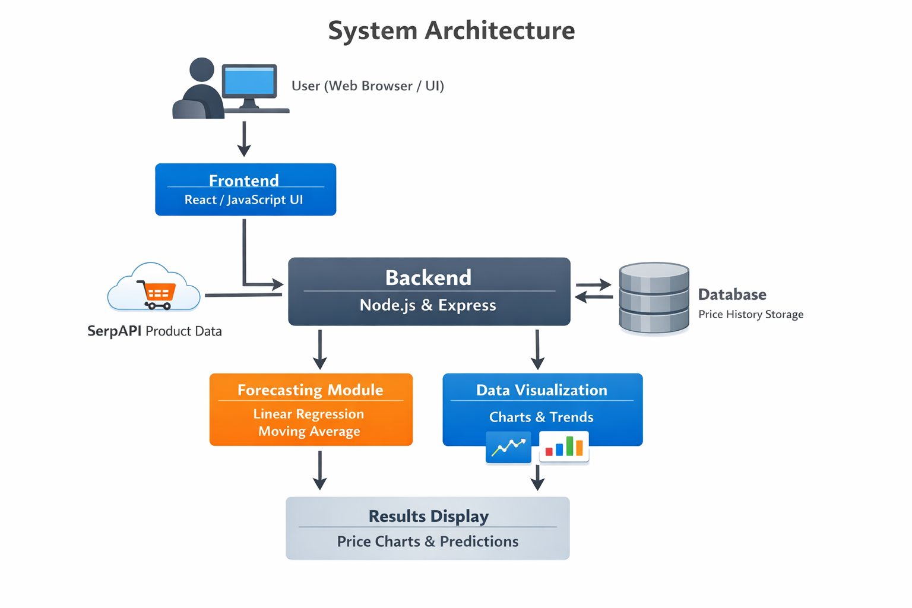
System Architecture

Slide 15
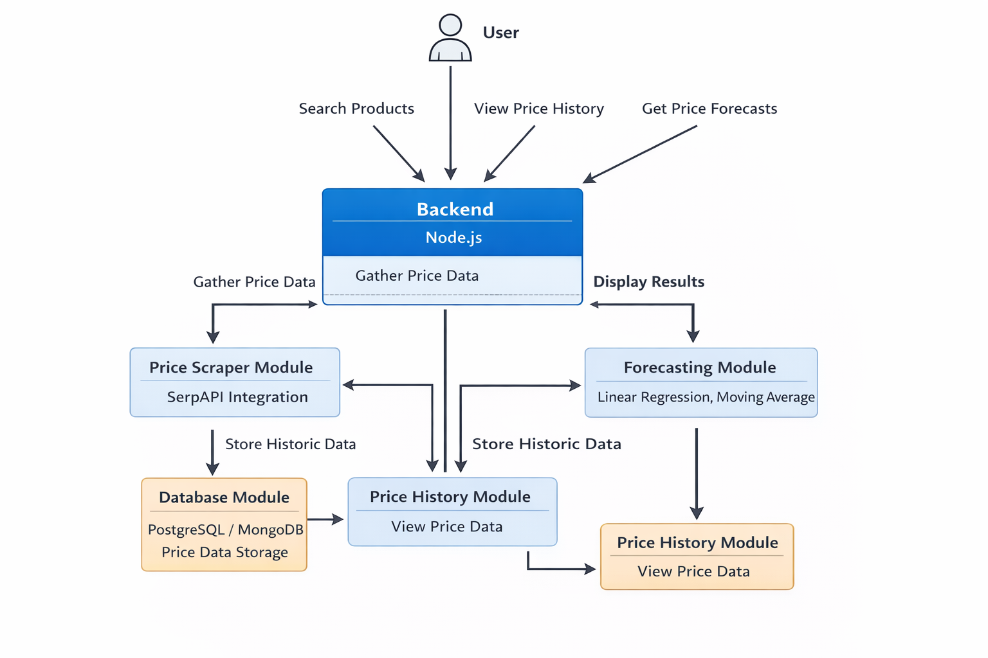
Uml diagram

Slide 16
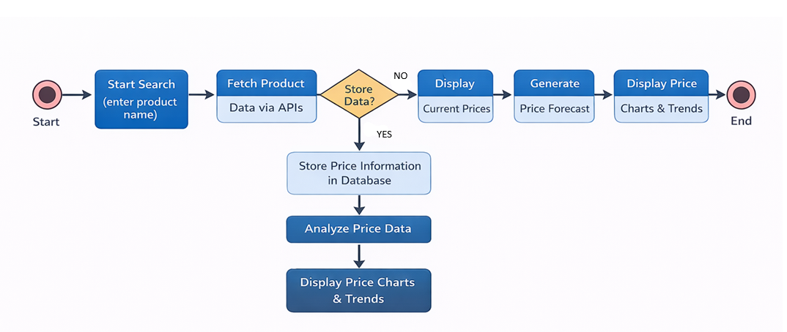
Activity diagram

Slide 17
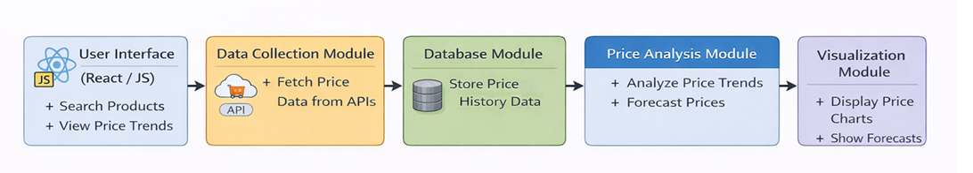
Module design

Slide 18


